Slide 1



Class 6: Machine Learning – Classification models
Unit II: Data Preparation and Predictive Models
Sebastián Muñoz-Herrera, PhD.
Héctor Hormazábal

Slide 2
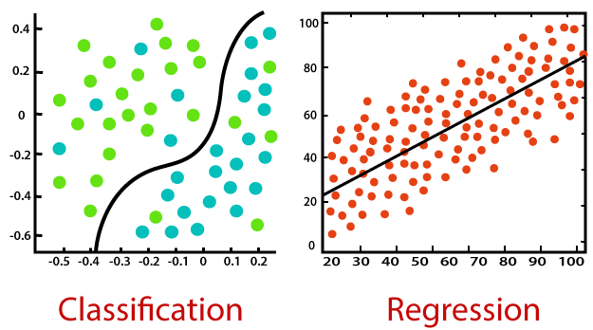
ML Classification models
State vs. Scale: Engineering systems often operate in binary states (Failure/Normal, Fraud/Legit) rather than continuous ranges.
Finding the Boundary: Our goal is to define the optimal function that separates these discrete classes in a multi-dimensional space.
Probability Mapping: Every prediction is a calculated likelihood based on historical patterns, not a deterministic guess.
Generalization: The model must accurately categorize new, unseen data points, avoiding the trap of simply memorizing the past.
Muñoz-Herrera and Hormazábal Class 6: Machine Learning – Classification models Data Preparation and Predictive Models
Notes:
Let me walk you through the four units of the course so you know exactly where we're headed.
Unit I, which starts today, covers the Fundamentals of Business Intelligence — what it is, how it works, where data comes from.
Unit II moves into Data Preparation and Predictive Models — this is where you'll get your hands dirty cleaning and modeling data.
Unit III is the exciting one: Advanced Analytics and Machine Learning.
And Unit IV brings it all together with a focus on communicating insights ethically to support decision-making.
Notice how the course is structured like a pipeline: first you understand BI, then you prepare data, then you build models, and finally you communicate results. Each unit builds on the previous one — so keeping up with the pace really matters.
If at any point you feel lost, reach out early. We'd rather help you now than rescue you at the final exam.

Slide 3
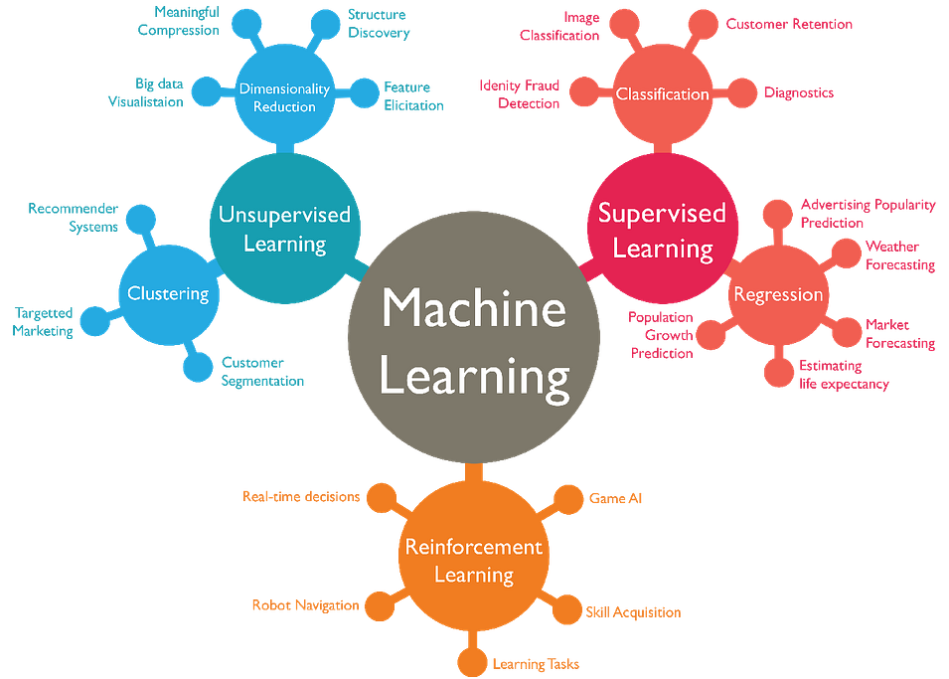
ML Classification models
Here we are!
Muñoz-Herrera and Hormazábal Class 6: Machine Learning – Classification models Data Preparation and Predictive Models
Notes:
Let me walk you through the four units of the course so you know exactly where we're headed.
Unit I, which starts today, covers the Fundamentals of Business Intelligence — what it is, how it works, where data comes from.
Unit II moves into Data Preparation and Predictive Models — this is where you'll get your hands dirty cleaning and modeling data.
Unit III is the exciting one: Advanced Analytics and Machine Learning.
And Unit IV brings it all together with a focus on communicating insights ethically to support decision-making.
Notice how the course is structured like a pipeline: first you understand BI, then you prepare data, then you build models, and finally you communicate results. Each unit builds on the previous one — so keeping up with the pace really matters.
If at any point you feel lost, reach out early. We'd rather help you now than rescue you at the final exam.

Slide 4
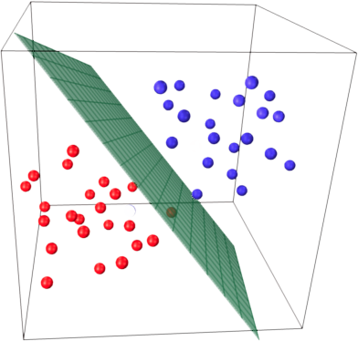
The Multi-Factor Reality
Complex Interactions: Industrial outcomes are rarely driven by a single factor. It’s the interaction between temperature, pressure, and vibration that signals a failure.
The Decision Boundary: In a 2D or 3D space, the "line" that separates classes becomes a hyperplane, allowing for a much more precise separation.
Statistical Power: Combining weak predictors can create a strong, robust model. One variable might be noisy, but ten variables together reveal a clear pattern.
Redundancy Management: Moving to multiple variables allows us to see which factors truly add value and which ones are just repeating the same information.
Muñoz-Herrera and Hormazábal Class 6: Machine Learning – Classification models Data Preparation and Predictive Models
Notes:
Let me walk you through the four units of the course so you know exactly where we're headed.
Unit I, which starts today, covers the Fundamentals of Business Intelligence — what it is, how it works, where data comes from.
Unit II moves into Data Preparation and Predictive Models — this is where you'll get your hands dirty cleaning and modeling data.
Unit III is the exciting one: Advanced Analytics and Machine Learning.
And Unit IV brings it all together with a focus on communicating insights ethically to support decision-making.
Notice how the course is structured like a pipeline: first you understand BI, then you prepare data, then you build models, and finally you communicate results. Each unit builds on the previous one — so keeping up with the pace really matters.
If at any point you feel lost, reach out early. We'd rather help you now than rescue you at the final exam.

Slide 5

Logistic Regression - Logistic Transformation
Linear predictor: We start with a weighted sum of inputs: (Continuous output)
$$y=β_{0}+β_{1} x_{1}+…+β_{n} x_{n}$$
The Logistic Function: To map $y∈ \left]−∞, +∞\right[$ into $P∈[0,1]$, we apply the transformation:
$$P=σ\left(y\right)=\frac{1}{1+e^{−y}}$$
The Logit Link: Mathematically, we are modeling the log-odds as a linear function:
$$ln\left(\frac{P}{1−P}\right)=β_{0}+β_{1} x_{1}+…+β_{n} x_{n}=β_{0}+\sum_{i=1}^{n}{β_{i} x_{i}}$$
Non-Linear Mapping: This ensures that as z increases, the probability approaches 1 asymptotically, never exceeding the logical bounds.
Muñoz-Herrera and Hormazábal Class 6: Machine Learning – Classification models Data Preparation and Predictive Models
Notes:
Let me walk you through the four units of the course so you know exactly where we're headed.
Unit I, which starts today, covers the Fundamentals of Business Intelligence — what it is, how it works, where data comes from.
Unit II moves into Data Preparation and Predictive Models — this is where you'll get your hands dirty cleaning and modeling data.
Unit III is the exciting one: Advanced Analytics and Machine Learning.
And Unit IV brings it all together with a focus on communicating insights ethically to support decision-making.
Notice how the course is structured like a pipeline: first you understand BI, then you prepare data, then you build models, and finally you communicate results. Each unit builds on the previous one — so keeping up with the pace really matters.
If at any point you feel lost, reach out early. We'd rather help you now than rescue you at the final exam.

Slide 6
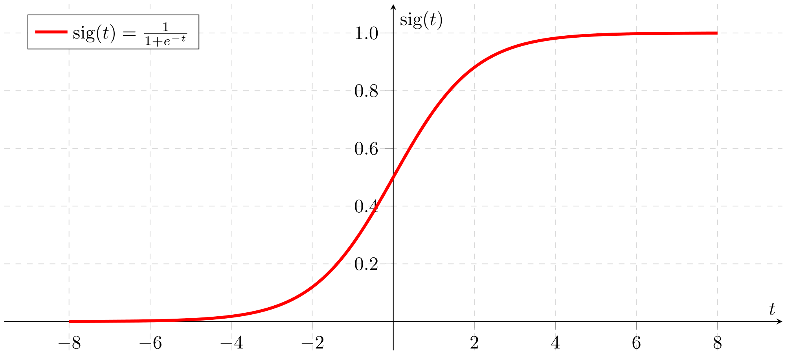
Logistic Transformation
Muñoz-Herrera and Hormazábal Class 6: Machine Learning – Classification models Data Preparation and Predictive Models
Notes:
Let me walk you through the four units of the course so you know exactly where we're headed.
Unit I, which starts today, covers the Fundamentals of Business Intelligence — what it is, how it works, where data comes from.
Unit II moves into Data Preparation and Predictive Models — this is where you'll get your hands dirty cleaning and modeling data.
Unit III is the exciting one: Advanced Analytics and Machine Learning.
And Unit IV brings it all together with a focus on communicating insights ethically to support decision-making.
Notice how the course is structured like a pipeline: first you understand BI, then you prepare data, then you build models, and finally you communicate results. Each unit builds on the previous one — so keeping up with the pace really matters.
If at any point you feel lost, reach out early. We'd rather help you now than rescue you at the final exam.

Slide 7
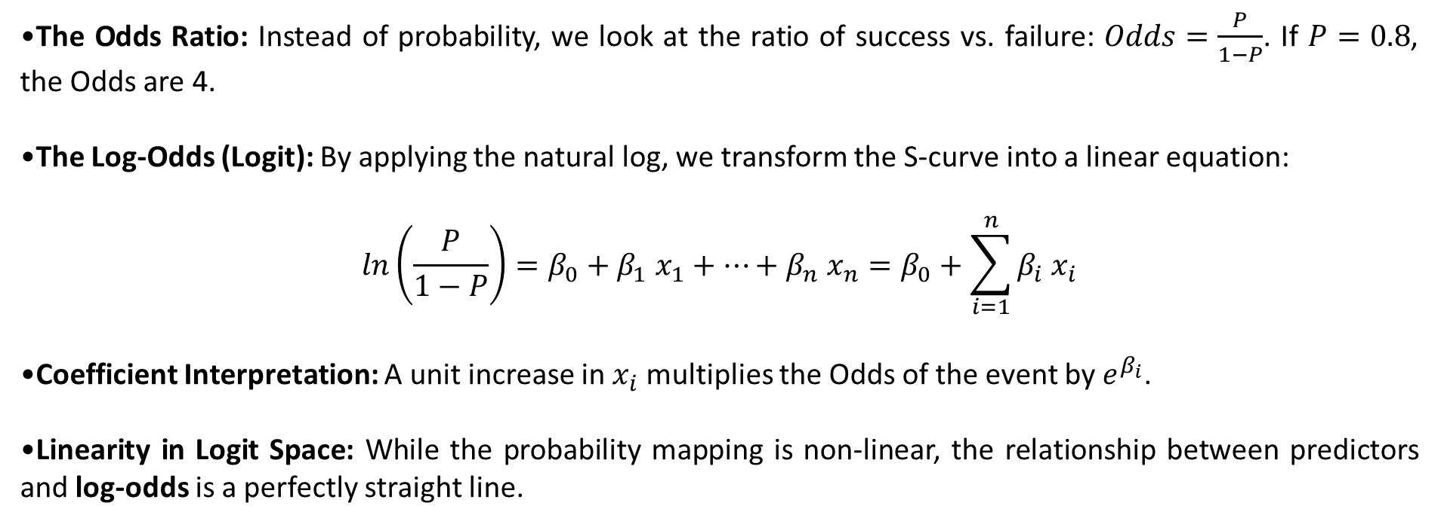
Interpreting the Logistic Model
The Odds Ratio: Instead of probability, we look at the ratio of success vs. failure: $Odds=\frac{P}{1−P}$​. If $P=0.8$, the Odds are 4.
The Log-Odds (Logit): By applying the natural log, we transform the S-curve into a linear equation:
$$ln\left(\frac{P}{1−P}\right)=β_{0}+β_{1} x_{1}+…+β_{n} x_{n}=β_{0}+\sum_{i=1}^{n}{β_{i} x_{i}}$$
Coefficient Interpretation: A unit increase in $x_{i}$ multiplies the Odds of the event by $e^{β_{i}}$.
Linearity in Logit Space: While the probability mapping is non-linear, the relationship between predictors and log-odds is a perfectly straight line.
Muñoz-Herrera and Hormazábal Class 6: Machine Learning – Classification models Data Preparation and Predictive Models
Notes:
Let me walk you through the four units of the course so you know exactly where we're headed.
Unit I, which starts today, covers the Fundamentals of Business Intelligence — what it is, how it works, where data comes from.
Unit II moves into Data Preparation and Predictive Models — this is where you'll get your hands dirty cleaning and modeling data.
Unit III is the exciting one: Advanced Analytics and Machine Learning.
And Unit IV brings it all together with a focus on communicating insights ethically to support decision-making.
Notice how the course is structured like a pipeline: first you understand BI, then you prepare data, then you build models, and finally you communicate results. Each unit builds on the previous one — so keeping up with the pace really matters.
If at any point you feel lost, reach out early. We'd rather help you now than rescue you at the final exam.

Slide 8
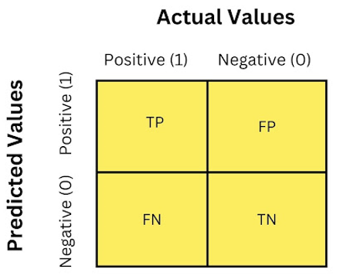
Evaluating Predictive Outcomes – Confusion Matrix
The Decision Rule: Converting the continuous probability (P) into a discrete class {0,1} using a threshold (typically τ=0.5).
Matrix Structure: A 2×2 contingency table comparing Predicted vs. Actual values. The Four Quadrants:
True Positives (TP): Correctly predicted the event (e.g., "Failure detected").
True Negatives (TN): Correctly predicted the absence (e.g., "Normal operation").
False Positives (FP): Type I Error. A false alarm; predicting an event that didn't happen.
False Negatives (FN): Type II Error. A missed event; predicting "Normal" when it actually failed.
Cost Asymmetry: In industrial systems, the cost of an FN (a crash) is usually much higher than an FP (an unnecessary check).
Muñoz-Herrera and Hormazábal Class 6: Machine Learning – Classification models Data Preparation and Predictive Models
Notes:
Let me walk you through the four units of the course so you know exactly where we're headed.
Unit I, which starts today, covers the Fundamentals of Business Intelligence — what it is, how it works, where data comes from.
Unit II moves into Data Preparation and Predictive Models — this is where you'll get your hands dirty cleaning and modeling data.
Unit III is the exciting one: Advanced Analytics and Machine Learning.
And Unit IV brings it all together with a focus on communicating insights ethically to support decision-making.
Notice how the course is structured like a pipeline: first you understand BI, then you prepare data, then you build models, and finally you communicate results. Each unit builds on the previous one — so keeping up with the pace really matters.
If at any point you feel lost, reach out early. We'd rather help you now than rescue you at the final exam.

Slide 9
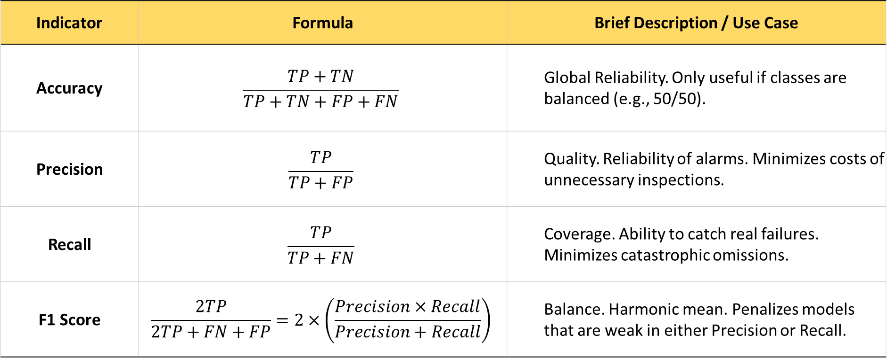
Assessing Performance: Key Performance Indicators (KPIs)
Indicator | Formula | Brief Description / Use Case
Accuracy | $$\frac{TP+TN}{TP+TN+FP+FN}$$ | Global Reliability. Only useful if classes are balanced (e.g., 50/50).
Precision | $$\frac{TP}{TP+FP}$$ | Quality. Reliability of alarms. Minimizes costs of unnecessary inspections.
Recall | $$\frac{TP}{TP+FN}$$ | Coverage. Ability to catch real failures. Minimizes catastrophic omissions.
F1 Score | $$\frac{2TP}{2TP+FN+FP}=2×\left(\frac{Precision×Recall}{Precision+Recall}\right)$$ | Balance. Harmonic mean. Penalizes models that are weak in either Precision or Recall.
Muñoz-Herrera and Hormazábal Class 6: Machine Learning – Classification models Data Preparation and Predictive Models
Notes:
Let me walk you through the four units of the course so you know exactly where we're headed.
Unit I, which starts today, covers the Fundamentals of Business Intelligence — what it is, how it works, where data comes from.
Unit II moves into Data Preparation and Predictive Models — this is where you'll get your hands dirty cleaning and modeling data.
Unit III is the exciting one: Advanced Analytics and Machine Learning.
And Unit IV brings it all together with a focus on communicating insights ethically to support decision-making.
Notice how the course is structured like a pipeline: first you understand BI, then you prepare data, then you build models, and finally you communicate results. Each unit builds on the previous one — so keeping up with the pace really matters.
If at any point you feel lost, reach out early. We'd rather help you now than rescue you at the final exam.

Slide 10
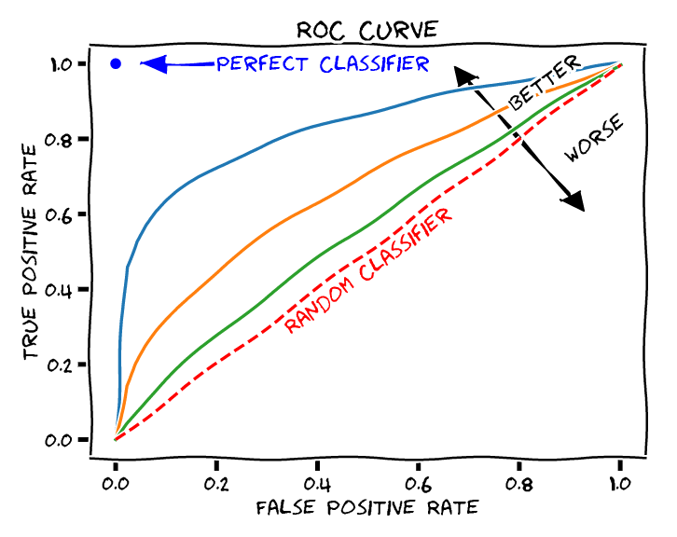
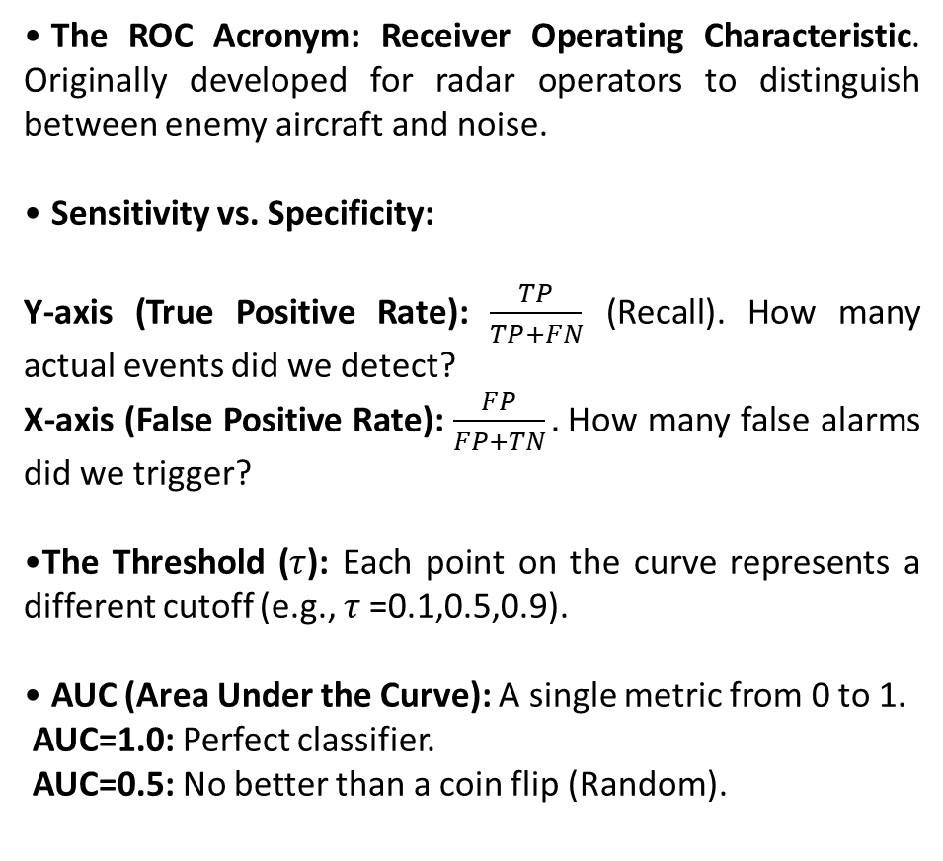
Dynamic Model Performance: The ROC Curve and AUC
The ROC Acronym: Receiver Operating Characteristic. Originally developed for radar operators to distinguish between enemy aircraft and noise.
Sensitivity vs. Specificity:
Y-axis (True Positive Rate): $\frac{TP}{TP+FN}$ (Recall). How many actual events did we detect?
X-axis (False Positive Rate): $\frac{FP}{FP+TN}.$How many false alarms did we trigger?
The Threshold ($τ$): Each point on the curve represents a different cutoff (e.g., $τ$=0.1,0.5,0.9).
AUC (Area Under the Curve): A single metric from 0 to 1.
AUC=1.0: Perfect classifier.
AUC=0.5: No better than a coin flip (Random).
Muñoz-Herrera and Hormazábal Class 6: Machine Learning – Classification models Data Preparation and Predictive Models
Notes:
Let me walk you through the four units of the course so you know exactly where we're headed.
Unit I, which starts today, covers the Fundamentals of Business Intelligence — what it is, how it works, where data comes from.
Unit II moves into Data Preparation and Predictive Models — this is where you'll get your hands dirty cleaning and modeling data.
Unit III is the exciting one: Advanced Analytics and Machine Learning.
And Unit IV brings it all together with a focus on communicating insights ethically to support decision-making.
Notice how the course is structured like a pipeline: first you understand BI, then you prepare data, then you build models, and finally you communicate results. Each unit builds on the previous one — so keeping up with the pace really matters.
If at any point you feel lost, reach out early. We'd rather help you now than rescue you at the final exam.

Slide 11
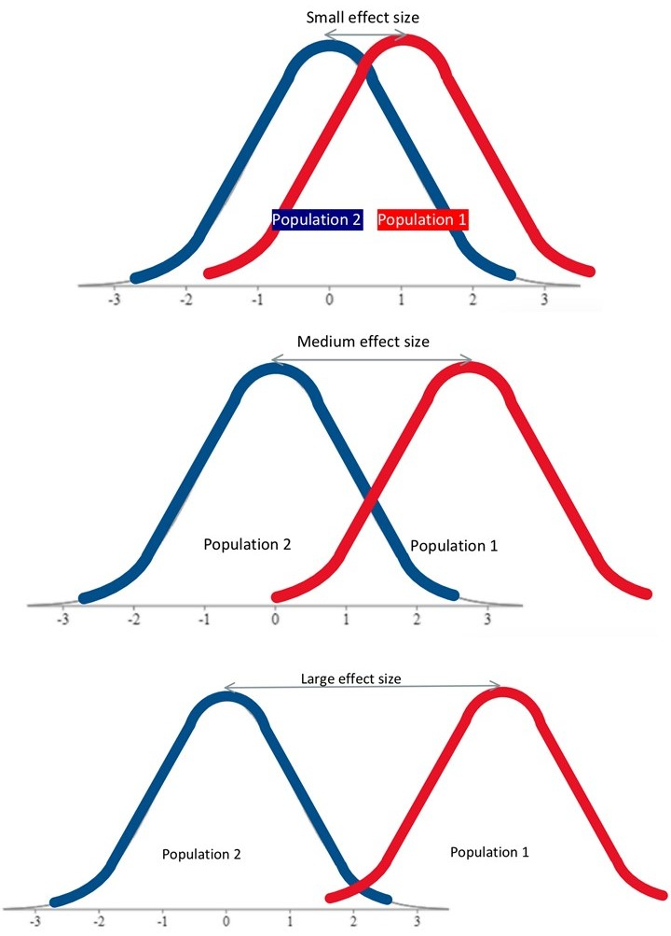
A/B Testing & Hypothesis Testing
The Goal: Compare two versions (A and B) to determine which one performs better based on a specific metric (e.g., Conversion Rate, Churn, total-average sales, etc). We seek to determine whether a certain claim about a population parameter can be rejected based on sample information.
Defining Hypotheses:
Null Hypothesis (H0​): There is no real difference between A and B. Any observed change is just "noise" or random chance.
Alternative Hypothesis (H1​): There is a significant difference caused by the change.
The p-value: The probability of observing our results if H0​ were actually true. If p-value < 0.05 (typical threshold), we Reject H0​ and claim "Statistical Significance.“
Randomization: Essential to ensure groups are identical except for the variable being tested.
Muñoz-Herrera and Hormazábal Class 6: Machine Learning – Classification models Data Preparation and Predictive Models
Notes:
Let me walk you through the four units of the course so you know exactly where we're headed.
Unit I, which starts today, covers the Fundamentals of Business Intelligence — what it is, how it works, where data comes from.
Unit II moves into Data Preparation and Predictive Models — this is where you'll get your hands dirty cleaning and modeling data.
Unit III is the exciting one: Advanced Analytics and Machine Learning.
And Unit IV brings it all together with a focus on communicating insights ethically to support decision-making.
Notice how the course is structured like a pipeline: first you understand BI, then you prepare data, then you build models, and finally you communicate results. Each unit builds on the previous one — so keeping up with the pace really matters.
If at any point you feel lost, reach out early. We'd rather help you now than rescue you at the final exam.

Slide 12
Assessing Performance: Key Performance Indicators (KPIs)
Use Case (Scenario) | Variable Type | Statistical Test | What does the p-value measure?
Comparing Means (e.g., Avg. spend in A vs. B) | Numerical (Continuous) | t-Test (Student) | Probability that the difference in means is due to chance.
Comparing Proportions (e.g., Churn Rate in A vs. B) | Categorical (Binary) | Z-Test | Probability that the difference in rates (%) is just noise.
Independence (e.g., Does region affect purchase?) | Categorical (Nominal) | Chi-Square (χ2) | Probability that the variables have no relationship at all.
Comparing >2 Groups (e.g., Test A vs. B vs. C) | Numerical | ANOVA | Probability that at least one group is different from the others.
Muñoz-Herrera and Hormazábal Class 6: Machine Learning – Classification models Data Preparation and Predictive Models
Notes:
Let me walk you through the four units of the course so you know exactly where we're headed.
Unit I, which starts today, covers the Fundamentals of Business Intelligence — what it is, how it works, where data comes from.
Unit II moves into Data Preparation and Predictive Models — this is where you'll get your hands dirty cleaning and modeling data.
Unit III is the exciting one: Advanced Analytics and Machine Learning.
And Unit IV brings it all together with a focus on communicating insights ethically to support decision-making.
Notice how the course is structured like a pipeline: first you understand BI, then you prepare data, then you build models, and finally you communicate results. Each unit builds on the previous one — so keeping up with the pace really matters.
If at any point you feel lost, reach out early. We'd rather help you now than rescue you at the final exam.

Slide 13

Practical Section
Google Colab — ML Classification Problem
Logistic Regression
Threshold
Performance metrics
Forecast
Muñoz-Herrera and Hormazábal Class 1: Introduction to Business Intelligence Unit 1: Fundamentals of Business Intelligence

Slide 14
Class 6: Machine Learning – Classification models
Unit II: Data Preparation and Predictive Models
Sebastián Muñoz-Herrera, PhD.
Héctor Hormazábal

